Slide 1
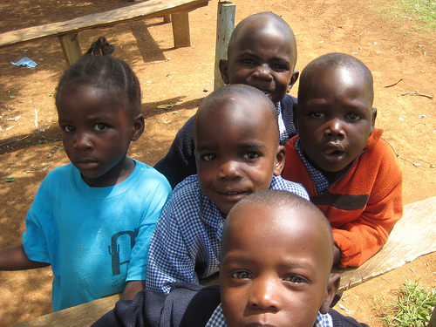
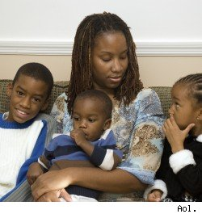
How to Improve Child Outcomes Through Fatherhood Programs
National Families and Fathers 17th Annual Conference
Rise Up Families
February 17, 2016
Los Angeles, California
Dr. Allen McCray, President Life Impact
Dr. Aida Diaz de Rodriguez, President, Asociacion de Maestros de Puerto Rico
Richard Noriega, President and CEO, AVANCE, Inc.
Robert Garcia, Regional Administrator, Administrator for Children and Families Region II
Dr. Blanca Enriquez, Director, Office of Head Start
Moderator
Dr. Claudia Sosa-Valderrama, Director, Long Beach Unified School District Head Start

Slide 2
Dr. Allen McCray, President & Founder of Life Impact,
San Juan, Puerto Rico
Phoenix, Arizona

Slide 3
A window to the soul
A behavioral personality profile is simply a window into our behavior, it is not the totality of who we are anymore than a window is the totality of a house.
It is a way of seeing ourselves in relationship to others. How we communicate and receive communications. Like a window it defines how we see the world and how the world sees us.

Slide 4
“Nothing is so powerful as insight into human nature…what compulsions drive a man, what instincts dominate his action…if you know these things about a man you can touch him at the core of his being.”
-William Bernbach

Slide 5
Ways of understanding our behavior
D
I
S
C
Influencing
Popular Charming
Conscientious
Perfect Organized
Decisive
Direct Powerful
Steady Peaceful
Slow paced

Slide 6
Ways of understanding our behavior
Popular
“I”
To have
fun
Peaceful
“S”
To have
peace
Perfect
“C”
Desires
perfection
Powerful
“D”
to be in
control
Emotional Needs
Attention, Affection
Acceptance, Approval
Controls by charm or being cute
Emotional needs Loyalty Appreciation
Credit for Work
Controls by threat of anger
Emotional needs
Peace and quiet,
Feeling of worth
Lack of stress, Respect
Controls by procrastination
Emotional Needs
Sensitivity Support
Space, Silence
Controls by threat of moods

Slide 7
Dr. Aida Diaz de Rodriguez, President, Asociacion de Maestros de Puerto Rico- San Juan, PR

Slide 8
The Dynamics of Puerto Rico
TOTAL POPULATION
3,705,344
65 + years:
17% (male 265.674/female 348.334)
55-64 years: 12% (male 197.256/female 238.139)
25-54 years: 38.5% (male 665.092/female 727.412)
15-24 years: 14.5% (male 267.596/female 256.487)
0-14 years: 18.1% (male 335.142/female 319.765)
48.1%
51.2%
male
Female
(2014 est.)
1,782, 398
1,922,946

Slide 9
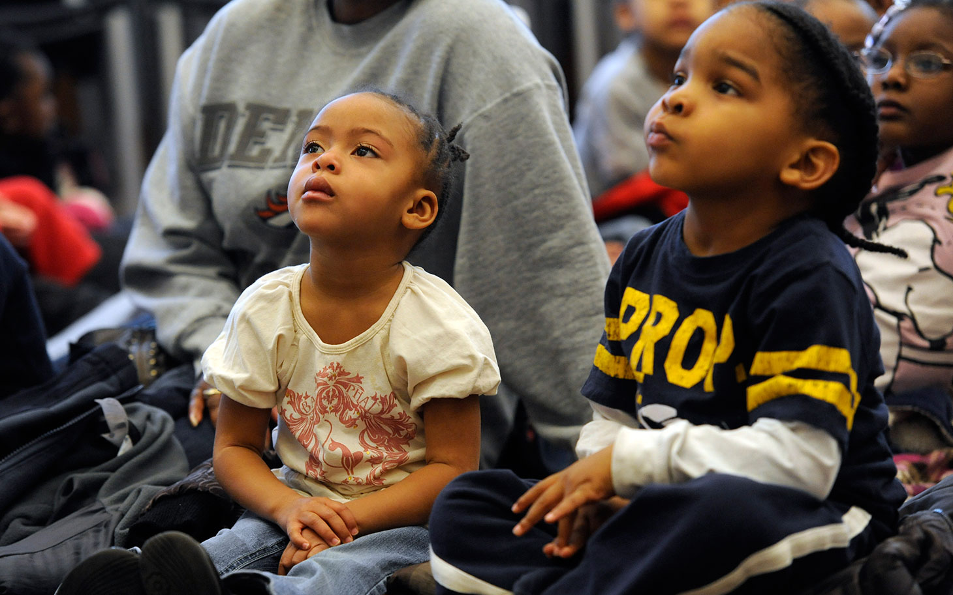
LOS PADRES ENCARCELADOS JÓVENES EN PUERTO RICO
Total of confined- 12,074
Confined with children- 7,980
Dependents from government programs before-6,164
Unemployed before confined- 6,826
Involved in illegal activities before confined- 1,670

Slide 10
Instituto Desarrollo Juventud de Puerto Rico
(0 -14 years) 651.907
50.8% of our kids live in single families
52.6% of kids living only with their father
46.5% of grand parents in charge of kids
0.7 % kids that live with others (not their parents or grand parents)
75% of no American immigrants under the age of 18 who live with their mother under the poverty level
125% Persons under 18 years in less than 125% below poverty level
6.4% single-parent families, (father) with children under 18 years where the father was in the labor force and employed

Slide 11
PROPÓSITO y PASIÓN
For everything in life , there is someone who turns it into something bigger than itself. Someone that makes it his or her passion. This is why his creations seem to be imbued with a soul.
We cannot live in a society where kids are suffering the absence of their father guide and love and do nothing about and hope it is going to work in the long run.

Slide 12
Fatherhood engagement is a shared responsibility of families, schools, and communities which occurs across the different stages of a child’s life through different settings.
HOME
CHILD
What can programs do to help engage families embrace the notion that fatherhood involvement is an important part of their child's healthy development in order to improve child outcomes?
SCHOOL
COMMUNITY

Slide 13
STRATEGIES TO IMPROVE OUTCOMES FOR FATHERS & CHILDREN IN PUERTO RICO
Recognize cultural diversity.
Provide mentors to guide and support fathers.
Integrate parental involvement strategies with parental involvement strategies under other programs.
Support families as they seek support from other community agencies.
Provide referrals to other resources.
Schools are our best resource, coordinate with them.
Coordinate with school personnel to welcome fathers and families to observe and participate in their child's classroom or home based activities.
Advocate and coordinate with teachers and school personnel preparation programs to include in their curriculum fatherhood involvement

Slide 14
STRATEGIES TO IMPROVE OUTCOMES FOR FATHERS & CHILDREN IN PUERTO RICO
Individualize opportunities for peer to peer connections.
Form partnerships with educational resources in the community and beyond.
Coordinate services for children and families as they transition from one early childhood setting to another.
Foster strong co-parenting relationships as appropriate.
Communicate, communicate, communicate.
Encourage teachers to ask kids to send text messages at specific hours during the day to their parents and vice versa.
Include fathers in decisions made by community leaders that concern their children.

Slide 15
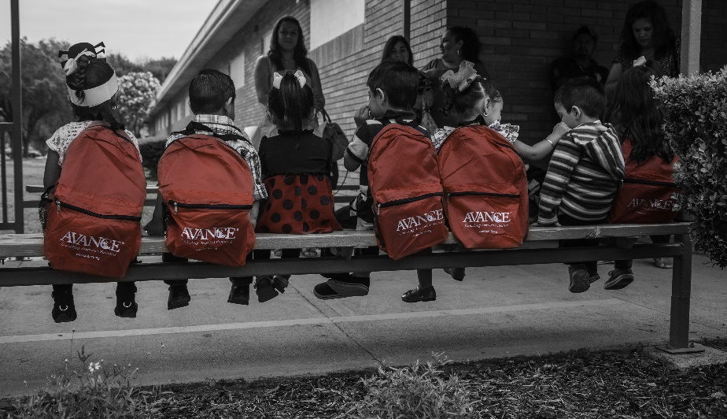
PROGRAMAS Y PROYECTOS
4
Seremos Grandes- Family Department - trainings for parents and guardians on socio-emotional development, health, safety and nutrition of their children
Redes de Apoyo Familiar – Family Department- multidisciplinary teams of professionals who work to empower communities: coexistence, sensory workshops, support groups for older adults, trainings in self-esteem, sex education , gender, referral to agencies, self-management.
1
5
Escuelas para la Convivencia y la Crianza- ADFAN- workshops aimed at building a culture of peace, self-reliance and self-management
2
Centros para el Desarrollo de la Primera Infancia- Sor Isolina –intervention, educational and technology training, community self-management
Taller de Crianza- Department of Education- during 3 hours weekly adolescent parents practice in bathing, feeding, talking and playing with their kids.
6
NACER- birth incubator of families - services to families of adolescents parents studying or working and the child born or unborn. (conflict management, skills for the maternity /paternity, business skills development. Taller Crianza (implements the curriculum: Partner's for Learning)
3
7
Fundamentos de la Crianza - Health Department - (group meetings, home visits, referrals, support groups)

Slide 16
Brigadier General Richard Noriega, President and CEO, AVANCE, Inc.- San Antonio, TX

Slide 17
Unlocking America’s potential by strengthening families in
at-risk communities through effective parent education
and support programs.

Slide 18
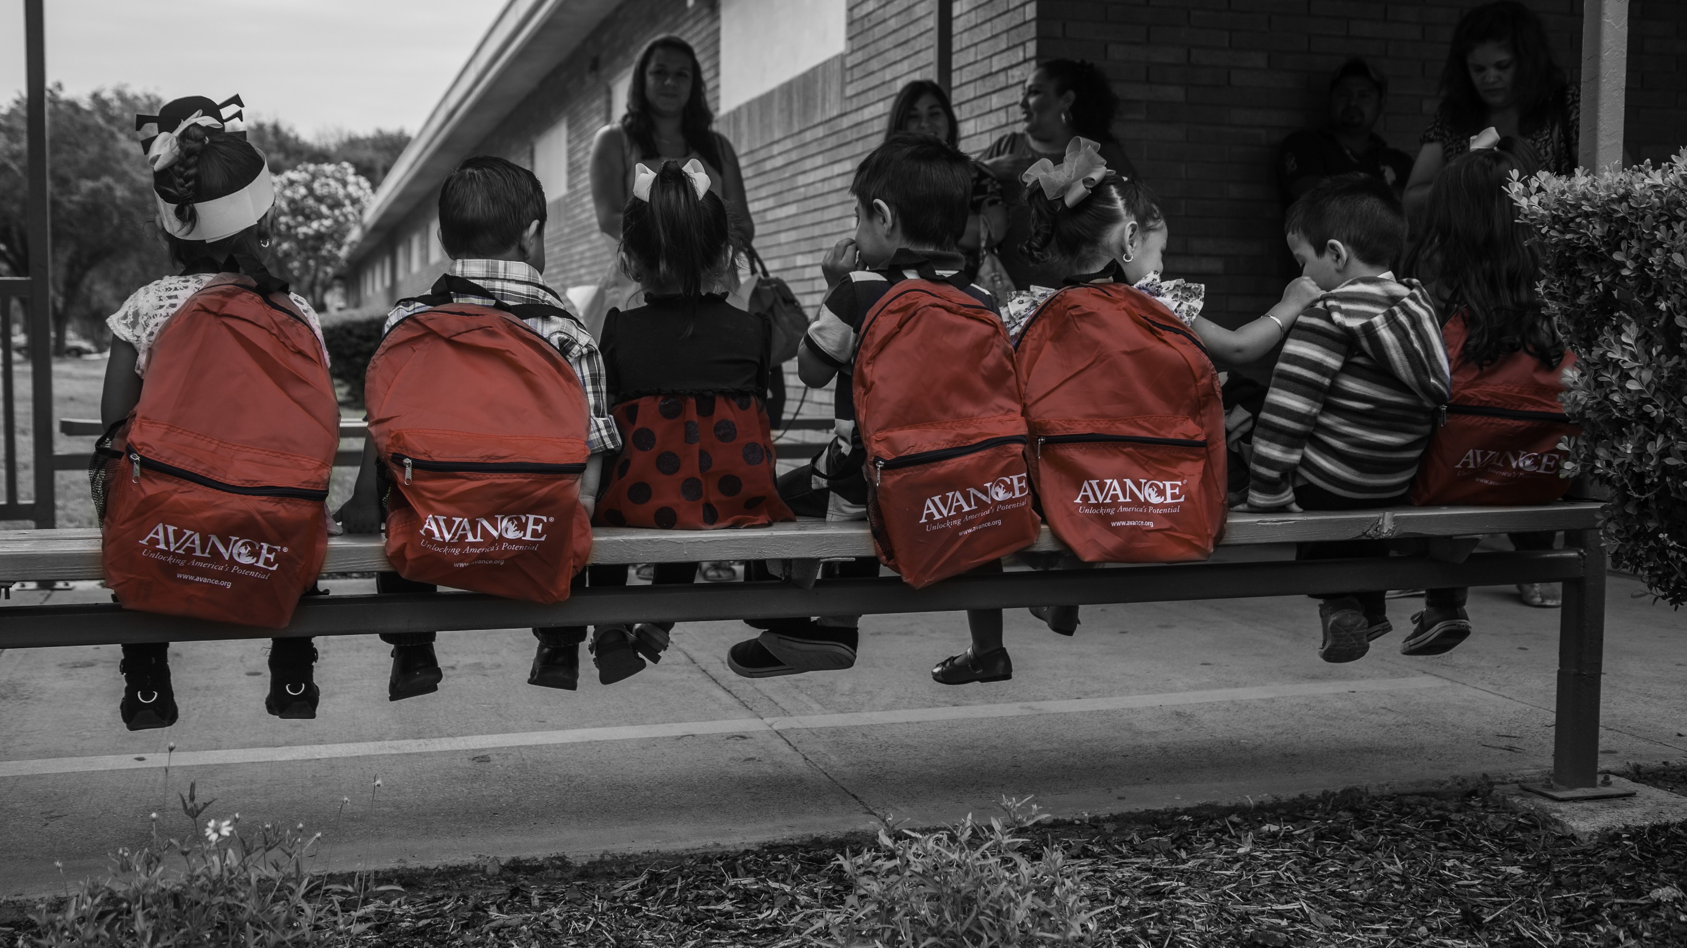
`
AVANCE best practices for engaging fathers 3,000 fathers served since 1998
2
1
Make programs welcoming to fathers
Treat participants with dignity and respect
Remove barriers to participation (transportation, child care, varied class times)
Match recruitment style to families
3
Preferred language and literacy levels
Match services to community needs
Recruit where they are (barber shops, churches, schools, parks, etc.)
Build trust between staff and participants
Hire staff who are accepting and non-judgmental
Ensure staff connect to community

Slide 19
`
Road to improving child outcomes starts with the parent
Addressing needs of the adults in their lives is critical
Toxic home environments affect children’s potential
Poverty
Abuse
Neglect

Slide 20
There is still hope...
Strengthen capacity of everyone who interacts with the child
Skill proficiency (executive function) doesn’t fully mature until ages 25-30

Slide 21
Improving Child Outcomes Through
Fatherhood Programs
ACF Region 9
Bob Garcia
Regional Administrator
February 17, 2016

Slide 22
Region 9 The U.S. Department of Health and Human Services Administration for Children and Families (ACF)
Region 9: Arizona, California, Hawaii, Nevada, American Samoa, Commonwealth of the Northern Mariana Islands, Federated States of Micronesia, Guam, Marshall Islands, and Republic of Palau.
What we do: ACF includes the broad range of federal programs that address the needs of children and families. These programs are at the heart of the federal effort to strengthen families and help all children succeed by bringing new ideas, insights and leadership on issues that impact the lives of all Americans.

Slide 23
ACF Programs that Connect Fathers to Children
Office of Family Assistance
Healthy Marriage and Fatherhood
Office of Child Support Enforcement
Child Support and Fatherhood Initiative
Office of Child Care and Head Start
Early Childhood Education
Children’s Bureau
Family Reunification

Slide 24
Healthy Marriage and Fatherhood (HMFR)
This initiative was launched in 2005 to promote stable relationships and positive child outcomes.
In 2010, Congress reauthorized the program and allocated $150 million annually to fund competitive grants, with funding equally split between healthy marriage and responsible fatherhood grants.
There are currently 121 HMRF grantees.
Funds support research and evaluation activities and the continuation of a national responsible fatherhood clearinghouse and media campaign.
Together, these activities are designed to promote and encourage healthy marriage and relationships, positive father and family interactions, economic stability, and collaboration activities to address the needs of at-risk families with a comprehensive approach.
The last round of grants was approved in September of 2015.

Slide 25
Bob Garcia
Regional Administrator
HHS, Region 9
415-437-8439
Robert.Garcia@acf.hhs.gov
Thank you!!!

Slide 26
Improving child outcome through fatherhood programs
Dr. Blanca E. Enriquez
2016 National Families and Fathers Coalition
17th Annual Conference
Los Angeles, CA
February 17, 2016
Thank you!!!

Slide 27
I as a Man
I as a Spouse
I as a Father
I as a Provider

Slide 28
Dedicated to all
-Fathers
-Grandfathers
-and Male Role Models
Thank You!

